Slide 1
DEPARTMENT OF CSE
COURSE NAME – CLOUD DEVOPS (EPAM)
COURSE CODE – 22cs2243f
Topic: storage fundamentals

Slide 2
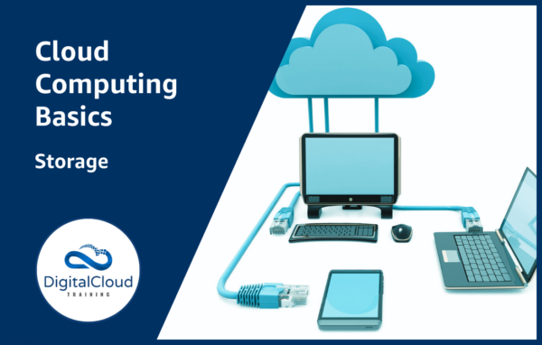
storage fundamentals

Slide 3
Storage fundamentals
. In cloud computing, cloud storage is a service offering with which a consumer is able to read and write data to cloud-based systems that are managed by a service provider. In this article, which is aimed at those who are new to cloud and computing in general, I discuss the basic concepts you need to understand to get started with storage on AWS.

Slide 4
Storage concepts
Cloud storage is usually accessible through a web service or application programming interface (API). The underlying infrastructure is typically a virtualized infrastructure stack with disk drives that are managed by a software service layer.
The most common form of cloud storage is object storage but any method of data management that can be offered as a service across a network can be used. The other cloud storage options are block-based storage and file-based storage and these will all be discussed later in this article.

Slide 5
storage Drive Types and Performance
Hard Disk Drives (HDD) have been around for a long while and are still in widespread use today. A HDD is a mechanical drive with spinning platters and a head that floats above the platters and moves into position to read and write data.
HDDs are also known as magnetic drives as they use magnetic polarization to record a one or zero value.
The performance of a HDD depends on a number of factors and these include the following measurements:

Slide 6
Revolutions Per Minute (RPM) – the speed of rotation of the platters
Seek time – the mean time it takes to move the head of a disk drive from one track to another
Input / Output Operations Per Second (IOPS) – the number of IO transactions per second
Throughput – the data transfer rate of a drive
HDDs provide good throughput, large capacity, and are extremely low cost.
Solid State Drives (SSD) store data on non-volatile microchips and have no moving parts. Non-volatile SSD chips differ from computer memory in that the data is retained when power is removed.

Slide 7
measuring data
Stored data is typically measured using the decimal system in kilobytes (kB), Megabytes (MB), Gigabytes (GB), Terabytes (TB) and Petabytes (PB).
In some cases the binary prefix is used such as gibibyte (GiB). A gibibyte is equal to 1024 mebibytes (MiB) while a gigabyte (GB) is equal to 1000 megabytes (MB).
To confuse matters a GB of computer memory is equal to 1024 MB (rather than 1000 MB) and some storage manufacturers have been known to use this measurement for disks too.
The following table shows how each term relates to the other in both the decimal and binary formats and the values are the number of bytes (a byte is 8 bits).

Slide 8
Data accessibility sla
Data Accessibility SLAs
Cloud service providers will often provide service level agreements (SLAs) for the availability and durability of their storage systems.
Availability relates to system uptime, i.e. the amount of time per month or year that the storage system is operational and can deliver data upon request. Service providers aim to increase availability by designing highly available and fault tolerant storage systems.
Availability is usually expressed as a percentage of uptime in a given year. The following table shows some common availability SLAs and how much downtime each corresponds with:

Slide 9
Durability of storage
Durability relates to measuring the amount of data that may be lost due to errors occurring when writing data. In other words, durability measures the likelihood of losing some of your data.
Durability is usually expressed as a percentage of reliability and can also be interpreted as the number of files that are likely to be lost in a given year.
The following table shows the four Amazon Simple Storage Service (S3) storage classes with their respective durability SLAs and how many files could be lost per year:

Slide 10
Registries
Third-party registry services: Fully managed offerings that serve as a central point of access to your own container images, providing a way to store, manage, and secure them without the operational headache of running your own on-premises registry. Examples of third-party registry offerings that support Docker images include Red Hat Quay, Amazon ECR, Azure Container Registry, Google Container Registry, and the JFrog Container Registry.
Self-hosted registries: A registry model favored by organizations that prefer to host container images on their own on-premises infrastructure – typically due to security, compliance concerns or lower latency requirements. To run your own self-hosted registry, you’ll need to deploy a registry server. Alternatively, you can set up your own private, remote, and virtual Docker registry.

Slide 11
Cloud Storage Types
As mentioned earlier cloud storage is generally object-based, block-based or file-based storage. These terms relate to the type of data stored, the protocols used to access it, and the method of data storage.
Object Storage
With object storage data is managed as individual objects rather than a file hierarchy (as with a traditional file system). Each object includes the data itself, metadata (data about the data), and a globally unique identifier.
Due to its flat file structure, object storage has virtually unlimited scalability and allows the retention of massive amounts of unstructured data. The data is often replicated across multiple physical systems and facilities providing high availability and durability.

Slide 12
Block Storage Data is stored and managed in bl
Block storage is typically used in Storage Area Network (SAN) environments that use the Fibre Channel (FC) protocol as well as Ethernet networks using protocols such as iSCSI or Fibre Channel over Ethernet (FCoE).
Block storage is typically more expensive than object or file storage but provides low latency, and high and consistent performance. The costs are often highest in SAN implementations due to the specialized equipment required.
Amazon Elastic Block Store (EBS) is the AWS service for block storage. EBS provides persistent block storage volumes for use with EC2 instances in the AWS cloud.
There are several EBS volume types to choose from with varying characteristics as can be seen in the table below:

Slide 13
Self Assessment Questions
What are the primary types of data storage?
What is the difference between volatile and non-volatile storage?
Explain the difference between primary storage and secondary storage.
What are the main functions of a storage controller?
Hard Disk Drives (HDD)

